Slide 1

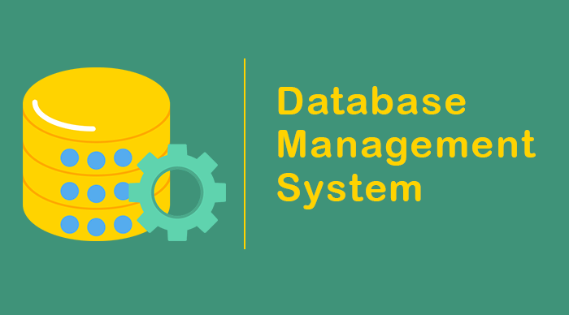
.

Slide 2
What is ER diagram? An Entity-Relationship (ER) diagram is a graphical representation used in database design and conceptual modeling. It visually displays the relationships among entities (objects or concepts) within a database and illustrates how they interact with each other. ER diagrams are commonly used in software engineering, database management, and other fields to provide a clear and concise visualization of a database's structure.

Slide 3
Components of ER Diagram Entities: These are the fundamental building blocks of an ER diagram. An entity represents a real-world object or concept with data that needs to be stored in a database. Each entity is typically depicted as a rectangle in the diagram. Attributes: Attributes are the properties or characteristics that describe an entity. They provide more detailed information about the entity. Attributes are typically displayed as ovals connected to their respective entities. Relation: Relationships illustrate how entities are connected or associated with each other. They represent the associations between entities and can be of various types, such as One-to-One, One-to-Many, and Many-to-Many. Relationships are often depicted as diamonds connecting entities.

Slide 4
Types of Entities Strong Entity Weak Entity

Slide 5
Types of Attributes Simple Attributes Key Attributes Composite Attributes Multivalued Attributes Derived Attributes

Slide 6
Types of Relation One to one One to Many Many to one Many to Many

Slide 7
Popular ER Software 1. Lucidchart 2. Draw.io 3. Microsoft Visio 4. Online platforms for collaborative design.

